Slide 1
Introduction to MCAS Computer-Based Testing
The Office of Student Assessment Services
January 17, 2024

Slide 2
Presenters
Jodie Zalk, Manager of Test Administration and Publications
Robert Pelychaty, Manager of Inclusive Assessment
Scott Kelley, Data and Reporting Specialist
Shannon Cullen, MCAS and ACCESS Assessment Specialist
Matthew Ingles, Pearson Customer Support Specialist

Slide 3
Logistics for This Session
Use the Q&A feature to ask a question.
We will answer some questions aloud at specified times during this training session, and we will email the Q&A afterwards.
Type your questions anytime, but we may not answer them in real time as some questions may be covered during the presentation.
Use the thumbs-up icon to “upvote” someone else’s question.
Email student-specific questions to mcas@doe.mass.edu instead of asking here.
This session is being recorded and will be available in about a week in the MCAS Resource Center, along with the slides.
Slides were also emailed out beforehand, and are being posted in the chat.
Closed captioning has been enabled for participants who need it.
This session is being interpreted into ASL. Our interpreting team will be onscreen with the presenters.

Slide 4
Slides for This Session
Slides were emailed to participants before this session from MCASEvents@cognia.org.
Slides are now being posted in the chat.
If you cannot access the slides in the chat, ask in the Q&A.
After the session, we will send the slides again to participants, and they will be posted in the MCAS Resource Center along with the recording.

Slide 5
Today’s Agenda
Overview of Computer-Based Testing
Tasks to Complete Now
Tasks to Complete at least Two Months Before Testing
Tasks to Complete at least Two Weeks Before Testing
Resources, Support, and Next Steps
Live “Sandbox Time”

Slide 6
Poll Question—3
What is your role? (Check all that apply)
District test coordinator
School test coordinator
Principal
Guidance counselor
Technology staff
Other district staff
Other school staff

Slide 7
1. Overview of Computer-Based Testing

Slide 8
MCAS Tests in 2023–24 School Year
Fall/Winter High School Tests
Spring 2024 Tests
November
ELA and Mathematics retests
February
Biology and Introductory Physics
March
ELA and Mathematics retests
Grades 3–8
ELA – all grades
Mathematics – all grades
STE – grades 5 and 8
Civics Field Test – grade 8
High School
ELA – grade 10
Mathematics – grade 10
Biology and Introductory Physics
See the statewide testing schedule for administration windows and prescribed dates for high school tests: www.doe.mass.edu/mcas/cal.html

Slide 9
Commonly Used Acronyms
CBT: Computer-based testing
PBT: Paper-based testing
PAN: PearsonAccess Next
SR/PNP: Student Registration/Personal Needs Profile
EL: English learner
ELA: English Language Arts
STE: Science and Technology/Engineering
SIMS: Student Information Management System

Slide 10
General Timeline for MCAS CBT
Pre-Administration Tasks
Beginning in Fall 2023
(Ongoing) Read biweekly Student Assessment Updates.
At least 2 months before testing
Update user accounts in PAN and create additional accounts.
At least 2 weeks before testing
Run App Check and conduct an Infrastructure Trial and/or Preliminary System Test.
Prepare students for online testing.
Become familiar with CBT components.
Identify the school test administration team.
Update contact info with DESE.
View online modules and participate in training sessions.
Meet with the technology coordinator, who will review the tech specs and prepare the school’s infrastructure.
Review instructions in the Principal’s Administration Manual.
Complete the SR/PNP.
Plan for accessibility features and accommodations.
Prepare devices and materials.
Delivered to schools 2 weeks before spring ELA, and one week before each fall/winter administration. Available online beforehand.
Train test administrators in protocols and security requirements.
Establish a communication plan with the test administration team.

Slide 11
Poll Question —3
Which of these have you been a part of previously? (Choose all that apply)
Submitting the SR/PNP file
Assigning accessibility features and accommodations
Infrastructure Trial
Preliminary System Test
None of the above

Slide 12
2. Tasks to Complete Now

Slide 13
General Timeline for MCAS CBT
Pre-Administration Tasks
Beginning in Fall 2023
(Ongoing) Read biweekly Student Assessment Updates.
At least 2 months before testing
Update user accounts in PAN and create additional accounts.
At least 2 weeks before testing
Run App Check and conduct an Infrastructure Trial and/or Preliminary System Test.
Prepare students for online testing.
Become familiar with CBT components.
Identify the school test administration team.
Update contact info with DESE.
View online modules and participate in training sessions.
Meet with the technology coordinator, who will review the tech specs and prepare the school’s infrastructure.
Review instructions in the Principal’s Administration Manual.
Complete the SR/PNP.
Plan for accessibility features and accommodations.
Prepare devices and materials.
Delivered to schools 2 weeks before spring ELA, and one week before each fall/winter administration. Available online beforehand.
Train test administrators in protocols and security requirements.
Establish a communication plan with the test administration team.

Slide 14
1. Read Student Assessment Updates (ongoing).
Student Assessment Updates are biweekly emails with important updates about the MCAS program.
The following roles in School and District Profiles automatically receive these updates:
Principals, MCAS test coordinators, special education directors, and EL program directors
If you do not already receive these updates, subscribe using this link: http://eepurl.com/ghSOhH

Slide 15
2. Become familiar with CBT components.
PearsonAccess Next
TestNav
ProctorCache

Slide 16
PearsonAccess Next
PearsonAccess Next
Online test management system for principals, test coordinators, technology coordinators, and test administrators
Need to create accounts for both sites (brown training and blue live site).
Primarily used for the following:
Managing user accounts
Student registration (SR/PNP)
Managing computer-based testing
Contact your District Test Coordinator if you need a new PAN login.
Resources
PAN Overview Video
PearsonAccess Next User Guide
User Role Matrix
Guide to Managing User Accounts in PAN

Slide 17
Timeline for Tasks in PAN
Approx. 2 months prior to testing
After initial SR/PNP through testing window as needed
At least 2 weeks before testing
2 weeks before testing
Submit Student Registration/ Personal Needs Profile (SR/PNP)
Continue to update information in PAN (SR/PNP)
Enrollment Transfer Requests (as needed)
Run App Check
Conduct Preliminary System Test and/or Infrastructure Trial
Create PAN Sessions and add students to them
Verify accommodations in PAN

Slide 18
TestNav
TestNav
Online testing platform used by students to take the computer-based MCAS assessments
Resources:
TestNav8 Online Support
Set up and Use TestNav
Troubleshooting

Slide 19
ProctorCache
ProctorCache
ProctorCache precaches test content onto a designated machine in a school to reduce bandwidth requirements. ProctorCache stores test content, but does not store student responses.
Only schools with lower bandwidth that do not pass the Network Check should use ProctorCache. See the resources below for detailed steps on how to decide whether to use ProctorCache.
Resources:
ProctorCache Recommendation for MCAS CBT
Set Up and Use ProctorCache
ProctorCache System Requirements

Slide 20
Demonstrations
Accessing resources from the DESE website
Accessing the DESE Security Portal
Accessing resources from the MCAS Resource Center
Logging in to PearsonAccess Next

Slide 21
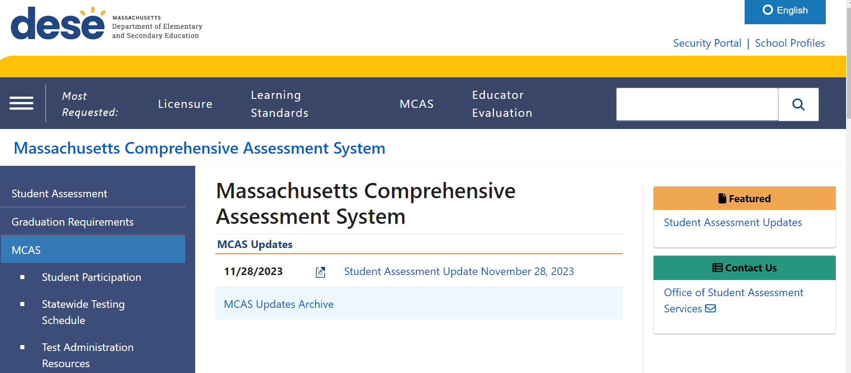
MCAS Page on the DESE Website
www.doe.mass.edu/mcas

Slide 22
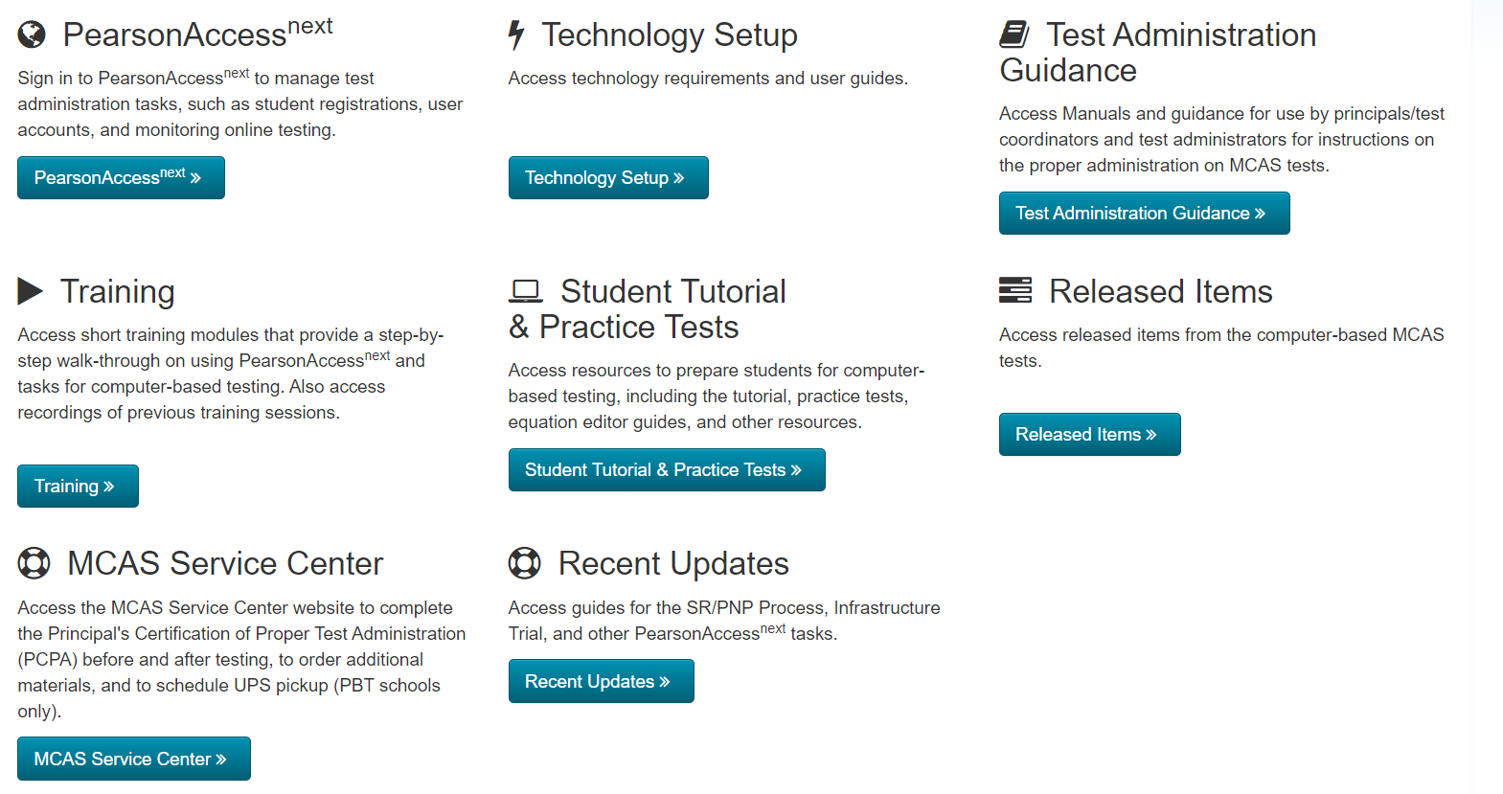
MCAS Resource Center
mcas.pearsonsupport.com

Slide 23
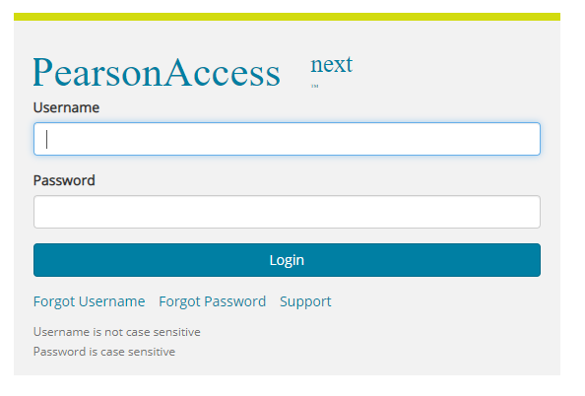
PearsonAccess Next
Link from the MCAS Resource Center: http://mcas.pearsonsupport.com/pearsonaccessnext/
Direct URL for the live site: https://mcas.pearsonaccess next.com/

Slide 24
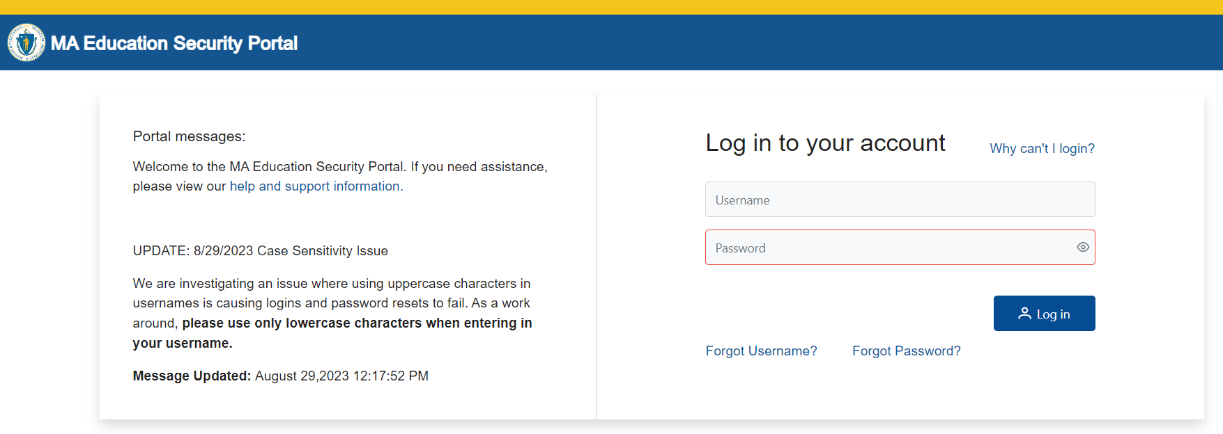
DESE Security Portal
Access Edwin and DropBox Central through the DESE Security Portal
Log in to the Security Portal at https://gateway.edu.state.ma.us/

Slide 25
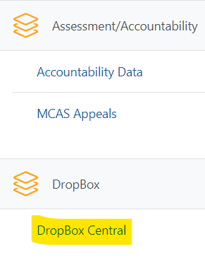
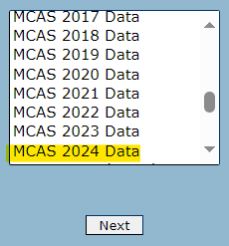
Accessing DropBox Central in the Security Portal
Enter your username and password.
You will then see an Application List.
Select DropBox Central.
Select MCAS 2024 Data for a list of students for each administration for spring MCAS testing.
Click Next.
For high schools: If a student is
listed in the .CSV
file but has already passed the test, contact mcas@doe.mass.edu.

Slide 26
3. Identify the test administration team.
Identify staff members who can help with planning and management of CBT:
Test coordination
Accessibility features for all students
Accommodations for students with disabilities and English learners
Technology set-up
Determine local responsibilities:
Who will schedule and manage test sessions?
Who will configure devices for testing?
Who needs access to PearsonAccess Next?
Who will be managing PAN during testing?
Who will verify that students have been assigned the correct accommodations and test forms prior to testing?

Slide 27
4. Establish a communication plan with the test administration team.
Principals, MCAS test coordinators, special education directors, and EL program directors automatically receive the Student Assessment Update.
Establish a plan for sharing applicable information from the Student Assessment Update with others as needed.
How will information be shared across the test administration team?
Encourage test coordinators and technology coordinators to subscribe.
Communicate information with educators, IEP teams, guidance counselors, and school-based tech staff as needed.
Consider which resources from the DESE website and MCAS Resource Center would be helpful for technology staff as well as test administrators, and share accordingly.

Slide 28
5. Update contact information with DESE.
DESE uses contact information in School and District Profiles to email the Student Assessment Update and other time-sensitive information.
Review contact information on the School and District Profiles page for:
MCAS Test Coordinator (district- and school-level; can assign to multiple individuals)
Educational Technology Director (district-level only)
Principals
Instructions on Updating Contact Information with DESE
Public school districts, public schools, charter schools, collaboratives, approved special education schools, & alternative education programs: | Test sites, adult education programs, out-of-state schools, SEIS-DYS programs:
Submit updates to your District-Level Directory Administrator. | Email your updates to ESEDirectoryAdministrator@mass.gov. Be sure to include your 8-digit school code and school name.

Slide 29
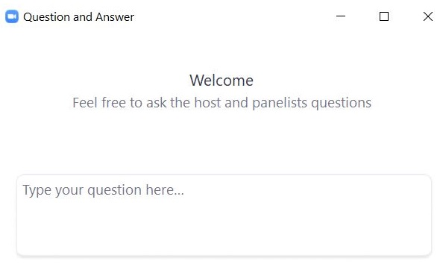
Questions and Answers
Use the “Q&A” feature to ask questions.

Slide 30
3. Tasks to Complete at least Two Months Before Testing

Slide 31
General Timeline for MCAS CBT
Pre-Administration Tasks
Beginning in Fall 2023
(Ongoing) Read biweekly Student Assessment Updates.
At least 2 months before testing
Update user accounts in PAN and create additional accounts.
At least 2 weeks before testing
Run App Check and conduct an Infrastructure Trial and/or Preliminary System Test.
Prepare students for online testing.
Become familiar with CBT components.
Identify the school test administration team.
Update contact info with DESE.
View online modules and participate in training sessions.
Meet with the technology coordinator, who will review the tech specs and prepare the school’s infrastructure.
Review instructions in the Principal’s Administration Manual.
Complete the SR/PNP.
Plan for accessibility features and accommodations.
Prepare devices and materials.
Delivered to schools 2 weeks before spring ELA, and one week before each fall/winter administration. Available online beforehand.
Train test administrators in protocols and security requirements.
Establish a communication plan with the test administration team.

Slide 32
6. Update user accounts in PAN and create additional accounts.
Five different roles provide different levels of access in PAN:
District test coordinator
School test coordinator
Technology coordinator
Test administrator
Published reports (add-on role)
Review the User Role Matrix for information on permissions for each role.
User accounts should be created by the school or district for appropriate staff members.
Schools will need to assign accounts for test administrators.
Refer to the Guide to Managing User Accounts in PearsonAccess Next for instructions on creating and editing user accounts.

Slide 33
Poll Question —3
Who is responsible for creating/updating PearsonAccess Next accounts for test administrators?
Principal or school test coordinator
District test coordinator
MCAS Service Center
DESE

Slide 34
6. Update contact information in PAN and create additional accounts. (cont’d)
Two PAN sites: live site and training site
Passwords on one site will always match the other.
The live site is used for operational testing.
The training site is used for Infrastructure Trials and Preliminary System Tests.
Accounts will need to be created on each site.
The PAN live site is expected to be available for the spring administrations on the first day of each SR/PNP window.
Note that accounts can be created at any time. Once an account is created, a user can view their organization’s current and previous administrations.

Slide 35
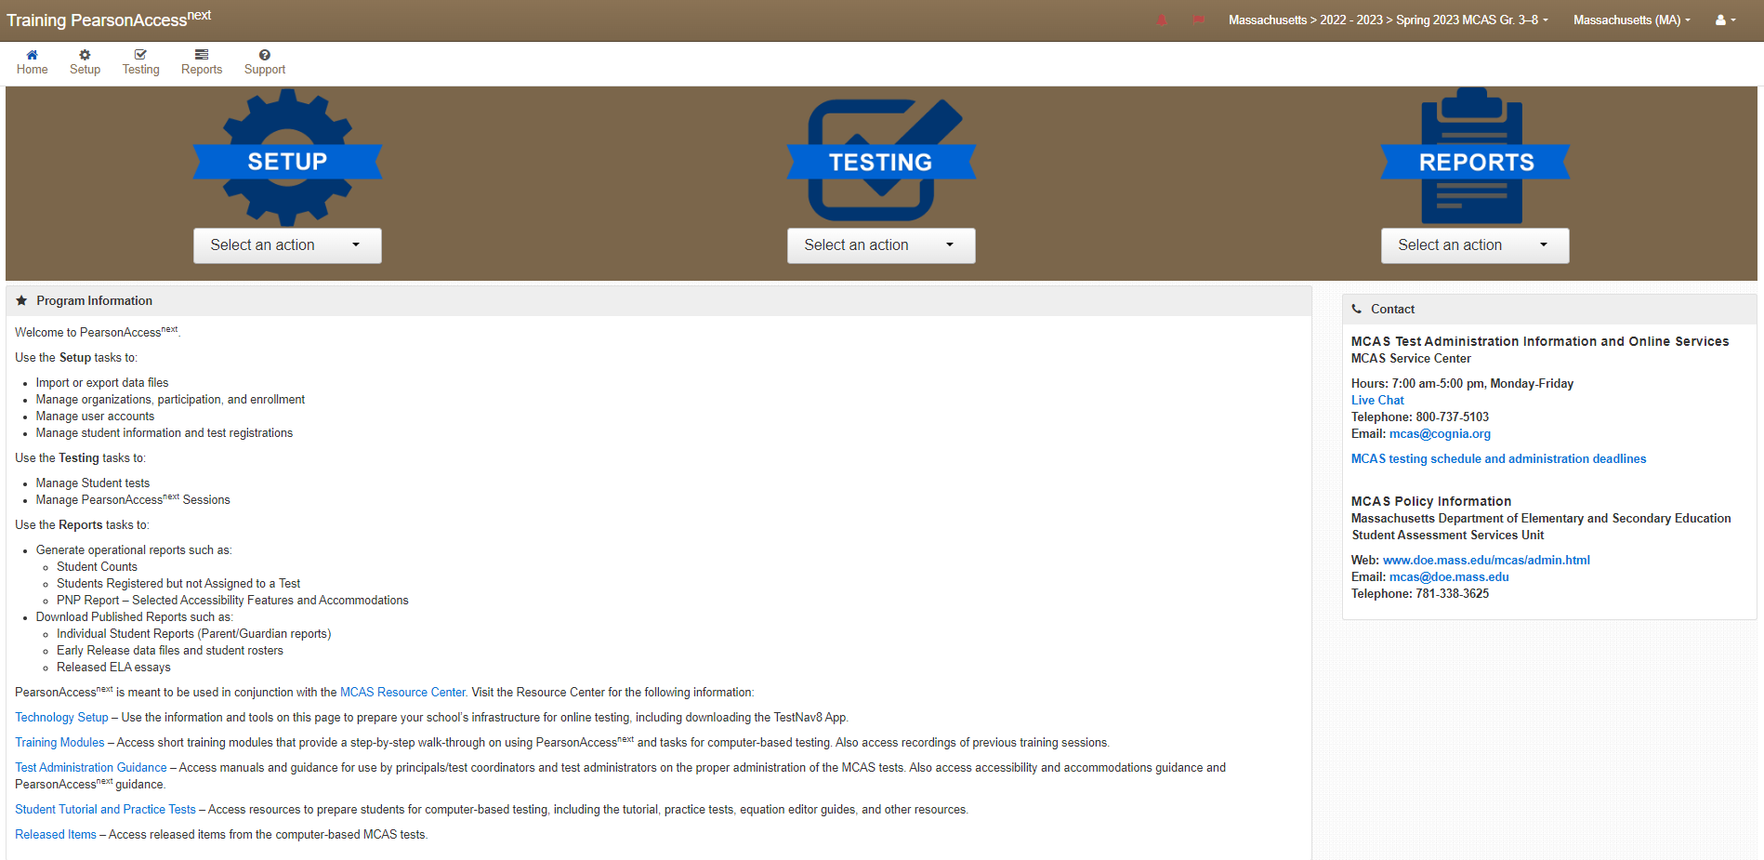
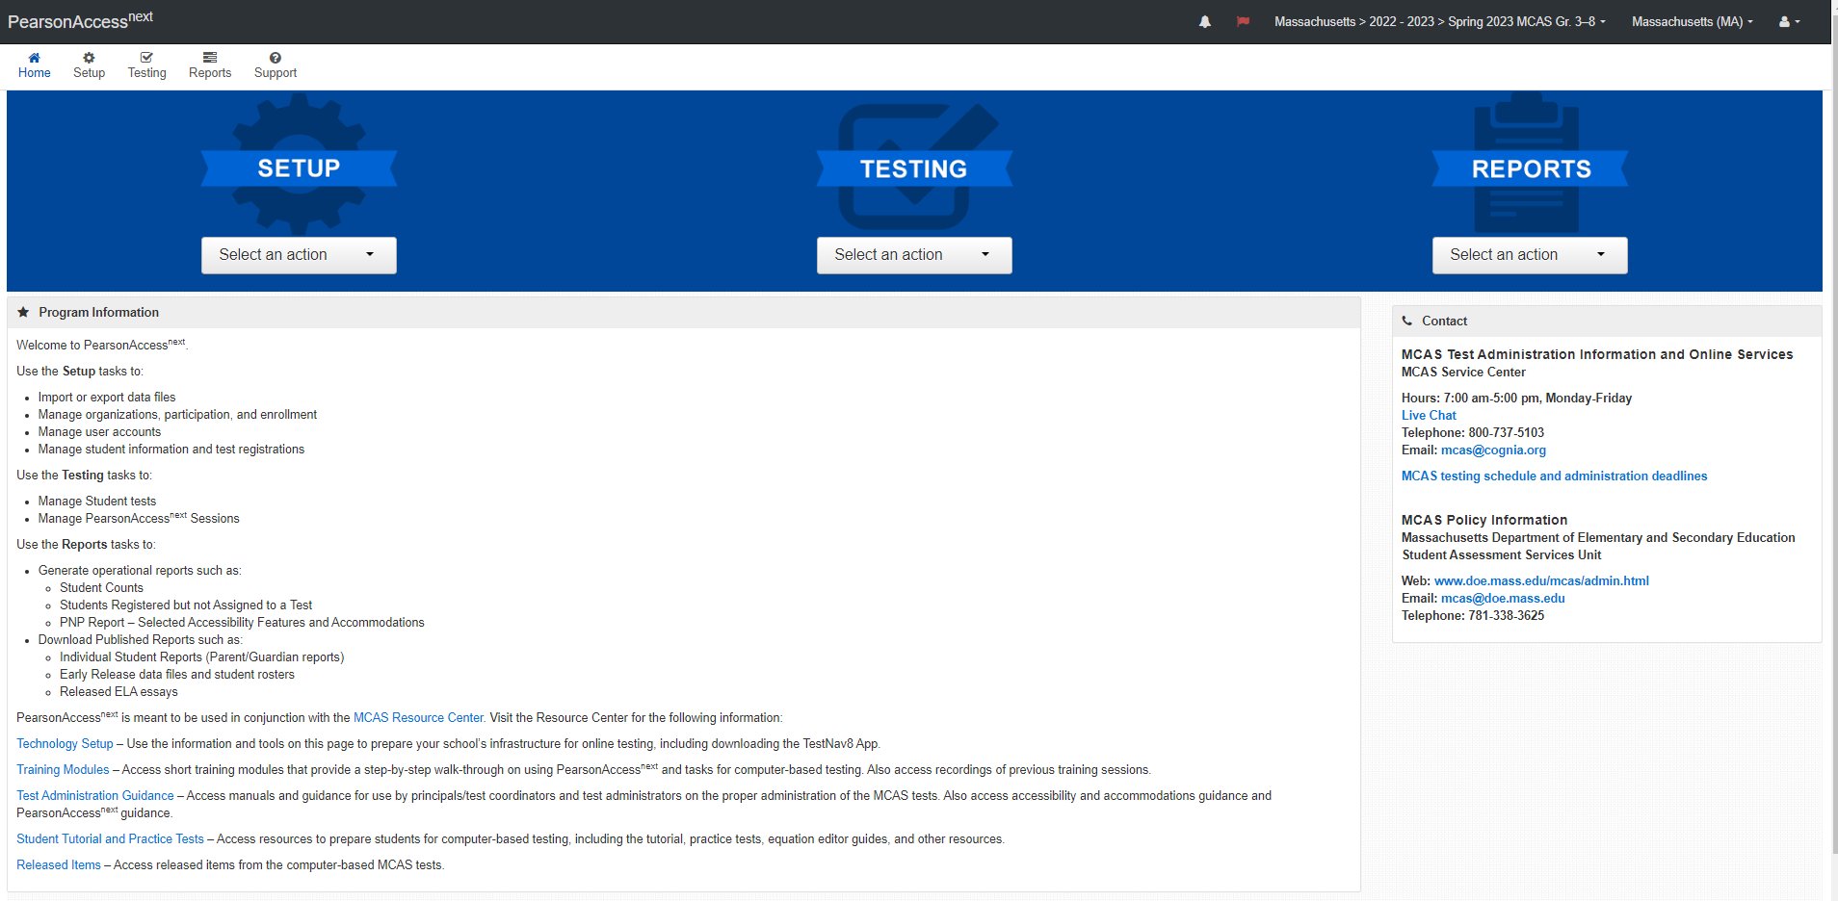
Demonstration
the brown training site vs. the blue live site

Slide 36
7. Plan for accessibility features (for all students) and accommodations for students with disabilities and English learners.
Review selected accessibility features for all students and accommodations for students with disabilities and ELs.
Include selected features and accommodations in the SR/PNP.
Before testing: required for student to receive correct test forms
After testing: to update features or accommodations used during testing
Resources:
Accessibility and Accommodations Manual
Guide to the SR/PNP Process
Register for the accessibility and accommodations training session
Online training module
Approved graphic organizers and supplemental Math & STE reference sheets

Slide 37
8. View online training modules and previous training sessions.
Visit the Training page on the MCAS Resource Center for modules as well as recordings/slides from previous live training sessions.
PAN Overview Video
PAN Tasks to Complete Before, During, and After Testing
Three separate trainings

Slide 38
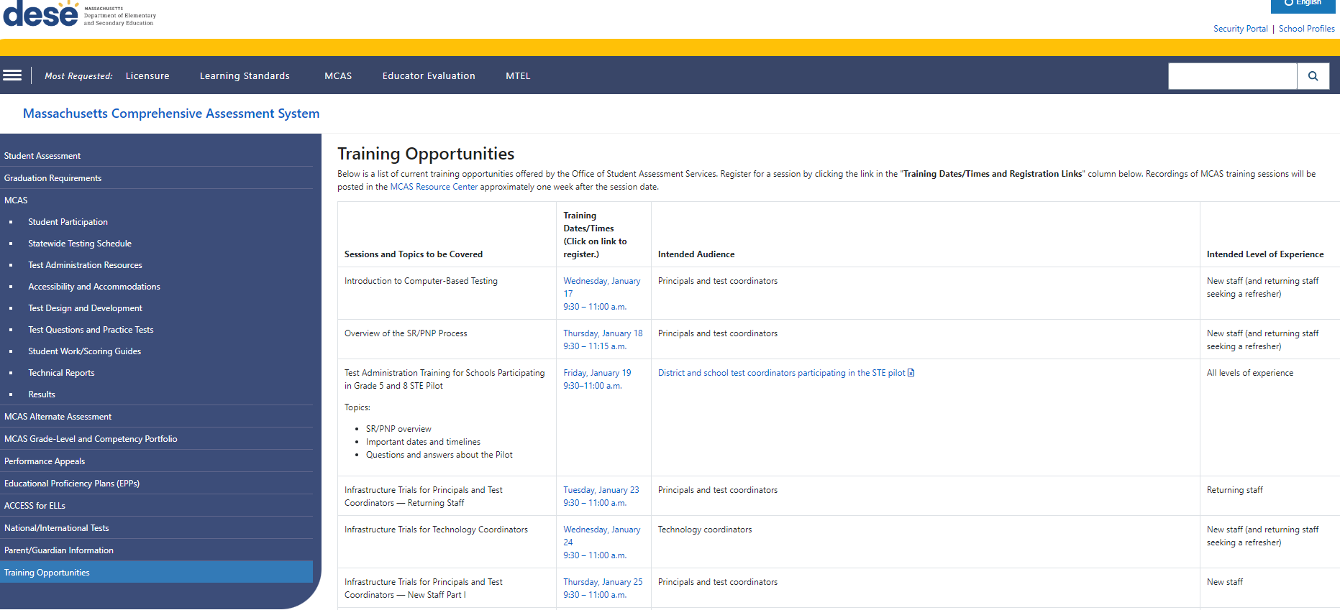
Register for upcoming training sessions at www.doe.mass.edu/mcas/training.html

Slide 39
9. Meet with the technology coordinator, review technology specifications, and prepare the school’s infrastructure.
Meet with the technology coordinator.
Review specifications and resources:
TestNav System Requirements
Minimum and recommended specifications for hardware and devices
Recommended levels of bandwidth
Note special instructions for ChromeOS (Chromebooks).
Confirm whether all devices planned for testing will meet these specifications.
Network Requirements and Guidelines
Note recent updates to TestNav and PearsonAccess Next

Slide 40
9. Meet with the technology coordinator, review technology specifications, and prepare the school’s infrastructure (continued).
Download the updated TestNav application on all testing devices.
Identify/address gaps in technology capacity such as
Potentially insufficient bandwidth
USDE guide on building technology infrastructure for learning
Follow the instructions for running a Network Check in the ProctorCache Recommendation for CBT

Slide 41
Poll Question —3
How do I know when the student registration window opens for each administration?
The dates are listed in the Test Administrator’s Manual
The dates are listed in the Statewide Testing Schedule
The dates are announced in Student Assessment Updates
Both B and C are correct

Slide 42
10. Complete the SR/PNP
The SR/PNP registers students for testing and places an initial order for PBT and for manuals.
SR/PNP windows for each administration are listed in the Statewide Testing Schedule.
Windows are also typically announced in the Student Assessment Update.
See the following resources:
Guide to the SR/PNP Process
Student Registration/Personal Needs Profile module
Overview of the SR/PNP Process training
Register for training on January 18

Slide 43
Questions and Answers
Use the “Q&A” feature to ask questions.

Slide 44
4. Tasks to Complete at least Two Weeks Before Testing

Slide 45
General Timeline for MCAS CBT
Pre-Administration Tasks
Beginning in Fall 2023
(Ongoing) Read biweekly Student Assessment Updates.
At least 2 months before testing
Update user accounts in PAN and create additional accounts.
At least 2 weeks before testing
Run App Check and conduct an Infrastructure Trial and/or Preliminary System Test.
Prepare students for online testing.
Become familiar with CBT components.
Identify the school test administration team.
Update contact info with DESE.
View online modules and participate in training sessions.
Meet with the technology coordinator, who will review the tech specs and prepare the school’s infrastructure.
Review instructions in the Principal’s Administration Manual.
Complete the SR/PNP.
Plan for accessibility features and accommodations.
Prepare devices and materials.
Delivered to schools 2 weeks before spring ELA, and one week before each fall/winter administration. Available online beforehand.
Train test administrators in protocols and security requirements.
Establish a communication plan with the test administration team.

Slide 46
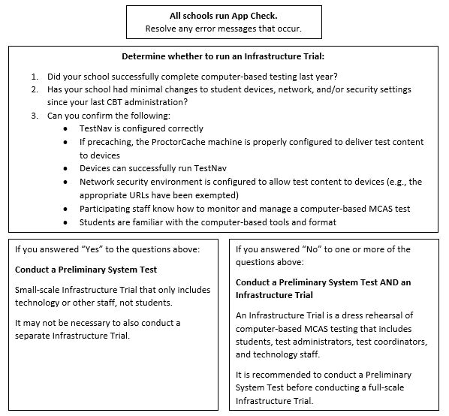
11. Run App Check and conduct an Infrastructure Trial or Preliminary System Test.
App Check
Ensures that devices and networks are set up correctly
All schools should run App Check in TestNav prior to testing
Takes only a few seconds per device. Instructions are in the Infrastructure Trial Guide.

Slide 47
Preliminary System Test
Recommended for all schools; strongly recommended for schools not participating in an Infrastructure Trial.
Prepare for CBT by ensuring that test content can be accessed on student devices on the school network.
Staff members log in and click through practice tests to ensure test content can be accessed.
When should we conduct a Preliminary System Test?
During the same window as the Infrastructure Trial
If you will be conducting an Infrastructure Trial, it is recommended to conduct the Preliminary System Test prior to the Infrastructure Trial.
Who should participate?
Technology or other staff

Slide 48
Infrastructure Trial
Prepare for CBT by simulating test day network use
When should we conduct a Trial?
Infrastructure Trial windows typically begin about 2 months before testing, and last until one week before testing.
It is recommended to conduct your school’s trial at least two weeks before testing.
Schools should not update their technology set-up or computers after conducting their trial.
Who should participate?
Test coordinators
Technology coordinators
Test administrators
Students

Slide 49
Purpose of the Infrastructure Trial
The Infrastructure Trial confirms that:
TestNav is configured correctly
If precaching, the ProctorCache machine is properly configured to deliver test content to devices
Devices can successfully run TestNav
Network security environment is configured to allow test content to devices (e.g., the appropriate URLs have been exempted)
Participating staff know how to monitor and manage a computer-based MCAS test
Students are familiar with the computer-based tools and format

Slide 50
Resources for the Infrastructure Trial and Preliminary System Test
Infrastructure Trial Readiness Guide
Infrastructure Trial for Principals and Test Coordinators module
Infrastructure Trial for Technology Coordinators module
Upcoming Trainings
Overview of Infrastructure Trials for Principals and Test Coordinators
For returning staff: January 23
For new staff: January 25 and 26
Overview of Infrastructure Trials for Technology Coordinators: January 24

Slide 51
12. Prepare devices and materials.
Plan to have enough devices for test administrators and for students.
Recommended tool: computer-based testing device planner
Ensure all devices will be charged prior to each test session.
Have materials available (and check to see if they are in working order):
Power cords, power strips, extra batteries, extra computers
If using tablets: external keyboards
If students are using text-to-speech: headphones
Schools may request to participate in BYOD (“bring your own device”) program by emailing MCAS@doe.mass.edu. More information will be provided in future Student Assessment Updates.

Slide 52
13. Prepare students for online testing.
Ensure the curriculum incorporates digital learning; review the DLCS Curriculum Framework
Student Tutorial
Demonstration of the navigation, tools, and features for CBT
Students complete it independently (no audio).
New for 2023–24: Student Tutorial Table of Contents
Describes what is on each page of the tutorial and for which administrations
Practice tests
Simulation of the tools and features for CBT
Include accessibility features and special editions:
For example, students can gain familiarity with the text-to-speech and web extensions that are available.

Slide 53
Additional Resources for Preparation
Additional resources for students
Sample student work and scoring guides
Released items
Answer keys and scoring rubrics for practice tests
Click on the subject, and then click on the grade.
Equation editor guides and symbol keys for Math and STE
Reference sheets for Math and STE (for all students)
Resources for parents/guardians

Slide 54
Demonstrations
Student tutorial
Practice tests

Slide 55
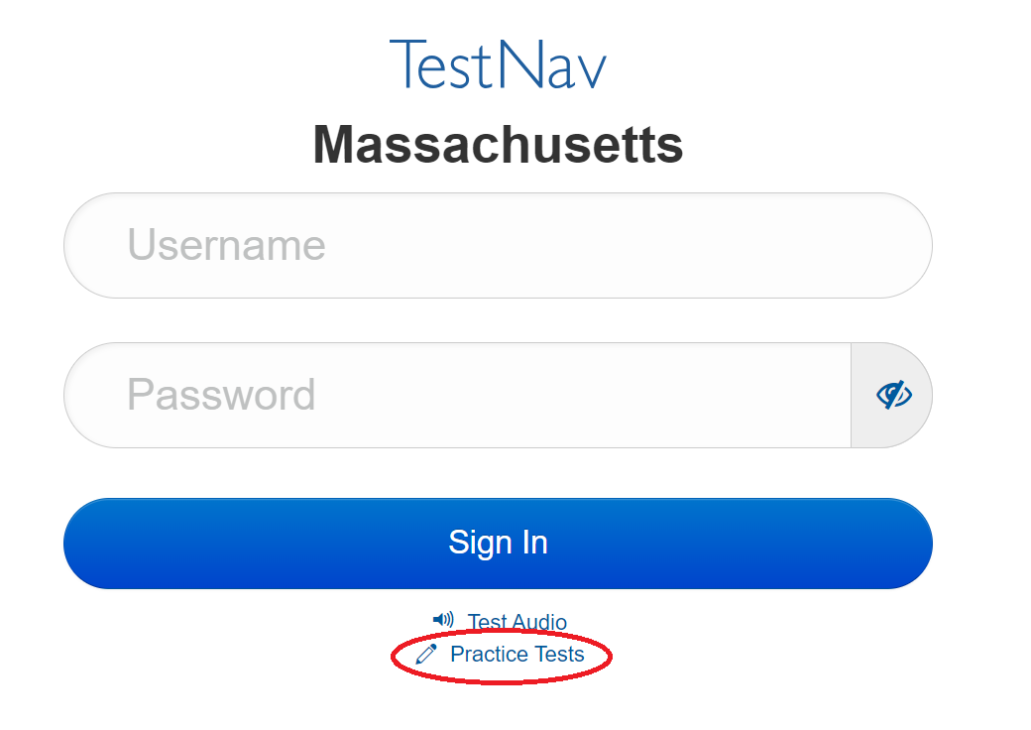
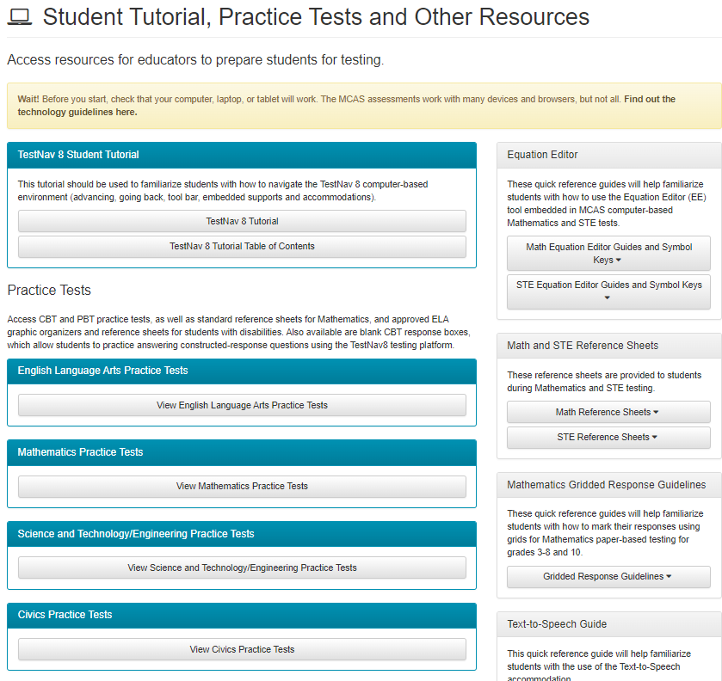
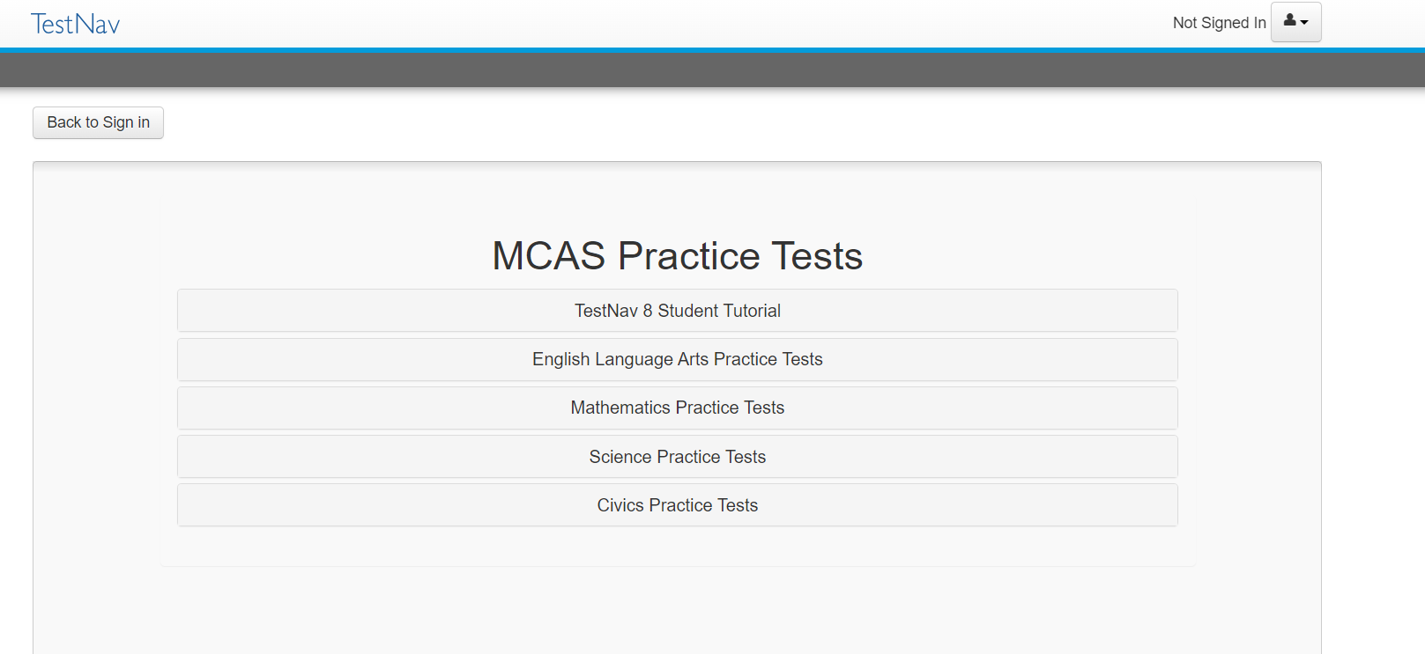
Accessing the Student Tutorial & Practice Tests
https://download.testnav.com
mcas.pearsonsupport.com/student

Slide 56
Questions and Answers
Use the “Q&A” feature to ask questions.

Slide 57
5. Resources, Support, and Next Steps

Slide 58
Additional Resources
Resource | Description
Home page | Access MCAS headlines and links to MCAS site (e.g., test schedule, test designs, training)
Student Assessment Updates | Biweekly email with important updates about the MCAS program If you do not already receive this email, subscribe at this link: http://eepurl.com/ghSOhH
MCAS Pre-Administration Guide | Instructions and roles/responsibilities for principals/test coordinators, new staff, and technology coordinators for tasks to complete prior to MCAS test administration, supplementing test administration manuals
PAN Tasks Timeline | Timeline of tasks to complete in PearsonAccess Next before, during, and after testing.

Slide 59
Additional Resources (continued)
Resource | Description
Test Designs | Access test designs for each of the subject tests.
Test Administration Resources | Test administration manuals and other resources for test administration.
Statewide Testing Schedule | Includes test administration dates and administration deadlines.
Student Participation Guidelines | Updated high school participation guidelines.

Slide 60
Upcoming Training Sessions
Date | Session | Audience
Thursday, January 18 | Overview of the SR/PNP Process | Principals and test coordinators
Tuesday, January 23 | Infrastructure Trials for Principals and Test Coordinators – Returning | Principals and test coordinators
Wednesday, January 24 | Infrastructure Trials for Technology Coordinators | Technology coordinators and technology staff
Thursday, January 25 | Infrastructure Trials for Principals and Test Coordinators – New Staff Part I | New principals and test coordinators
Friday, January 26 | Infrastructure Trials for Principals and Test Coordinators – New Staff Part II | New principals and test coordinators
Registration for training sessions available now: www.doe.mass.edu/mcas/training.html
After each session is delivered, a recording of the session and the slides will be posted at mcas.pearsonsupport.com/training/ approximately one week later.

Slide 61
Upcoming Training Sessions (continued)
Date | Session | Audience
Tuesday, January 30 Thursday, February 1 | MCAS Accessibility and Accommodations | Principals, test coordinators, special education administrators and supervisors, test administrators
Wednesday, January 31 | MCAS Test Security and Administration Protocols for Returning Staff | Principals, test coordinators, and test administration teams
Friday, February 2 | MCAS Test Security and Administration Protocols for New Staff | Principals, test coordinators, and test administration teams
Monday, February 5 | Pre-Administration Tasks for Technology Staff | Technology coordinators and technology staff
Registration for training sessions available now: www.doe.mass.edu/mcas/training.html
After each session is delivered, a recording of the session and the slides will be posted at mcas.pearsonsupport.com/training/ approximately one week later.

Slide 62
Future Training Sessions
Date | Session | Audience
Tuesday, February 27 | Tasks in PAN Before Testing | Principals and test coordinators
Thursday, February 29 | PAN Tasks for Accessibility and Accommodations | Principals, MCAS test coordinators, special education administrators and supervisors, and test administrators administering accessibility features for all students and accommodations for students with disabilities and EL students
Tuesday, March 12 | Tasks in PAN During Testing | Principals and test coordinators
Thursday, March 14 | Tasks in PAN After Testing | Principals and test coordinators
Registration for training sessions available now: www.doe.mass.edu/mcas/training.html
After each session is delivered, a recording of the session and the slides will be posted at mcas.pearsonsupport.com/training/ approximately one week later.

Slide 63
Next Steps
Today: Complete the evaluation form.
Responses are associated with the name and email address used to log in.
Email your input to mcas@doe.mass.edu if you have problems accessing or completing the form.
Within one week:
Receive an email with the Q&A from this session
Recording will be available

Slide 64
Email and Phone Support
MCAS Service Center
DESE Student Assessment Services
Questions on logistics and technology (e.g., PearsonAccess Next, SR/PNP, TestNav)
Web: mcas.pearsonsupport.com
Email: mcas@cognia.org
Phone: 800-737-5103
Schedule Technology Support Call
Policy questions (e.g., student participation, accommodations, “I have a student who…”)
Web: www.doe.mass.edu/mcas
Email: mcas@doe.mass.edu
Phone: 781-338-3625

Slide 65
6. Live “Sandbox Time”

Slide 66
Poll Question —3
Which demonstrations would you like to see again?
Accessing resources from the DESE website
Accessing resources from the MCAS Resource Center
Accessing the DESE Security Portal
Logging in to PearsonAccess Next
PAN training site vs. PAN live site
Accessing the student tutorial and practice tests

Slide 67
THANK YOU
The Office of Student Assessment Services
781-338-3625
mcas@doe.mass.edu
www.doe.mass.edu/mcas
135 Santilli Highway, Everett, MA 02149

